Slide 1
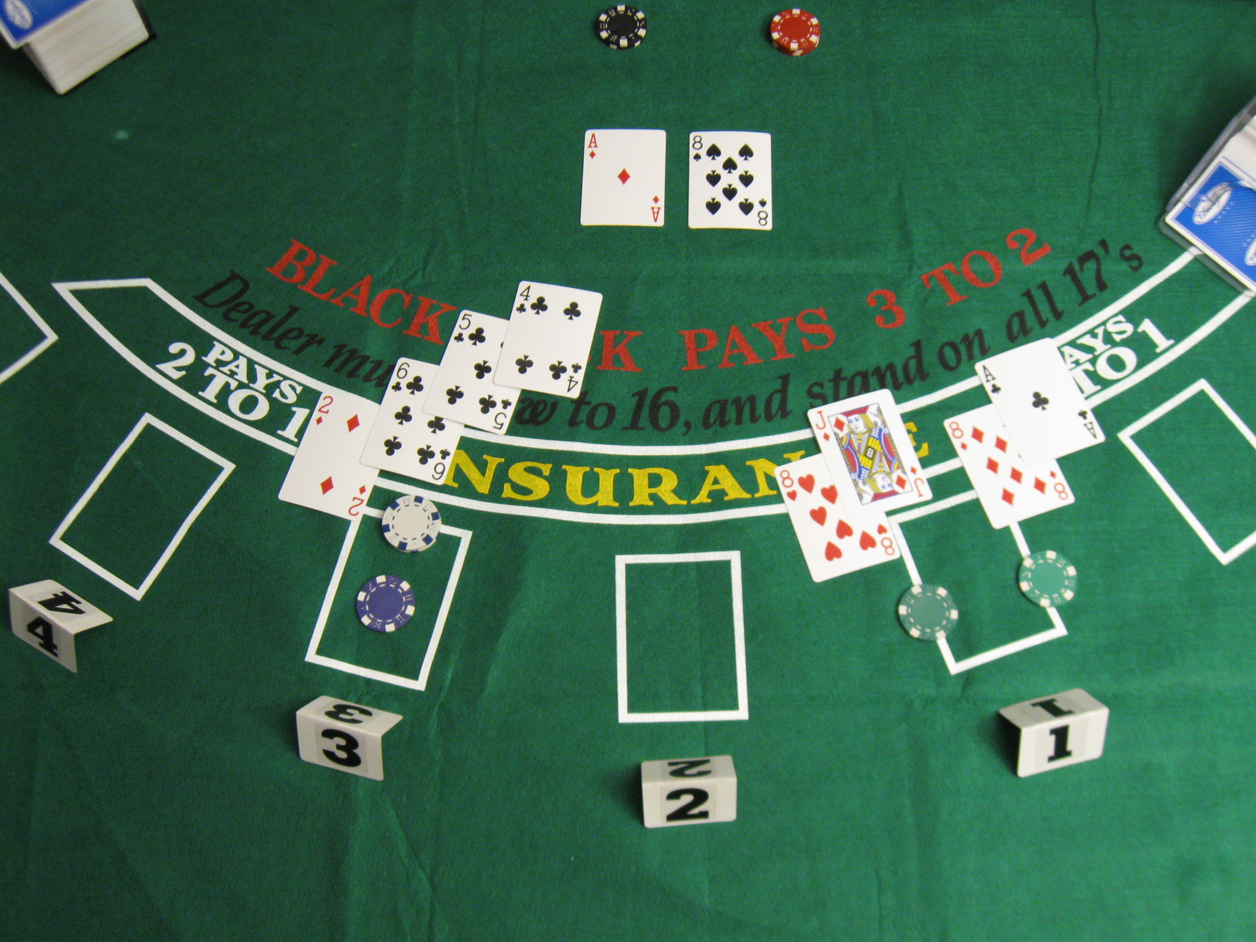

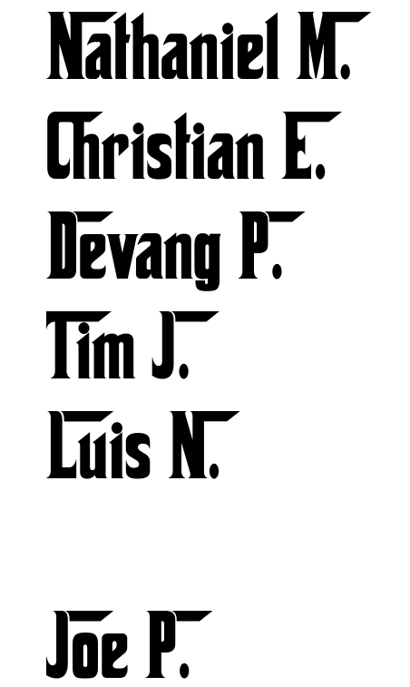



Slide 2

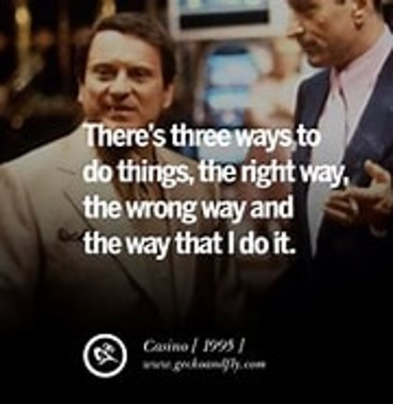
Get the Data
Clean the Data
Train 3 Random Forest Models
Integrate the models' predictions into a game of Blackjack
Group 5 does it.

Slide 3

Blackjack basics
The rules of the game
The Basic (optimal) strategy

Slide 4
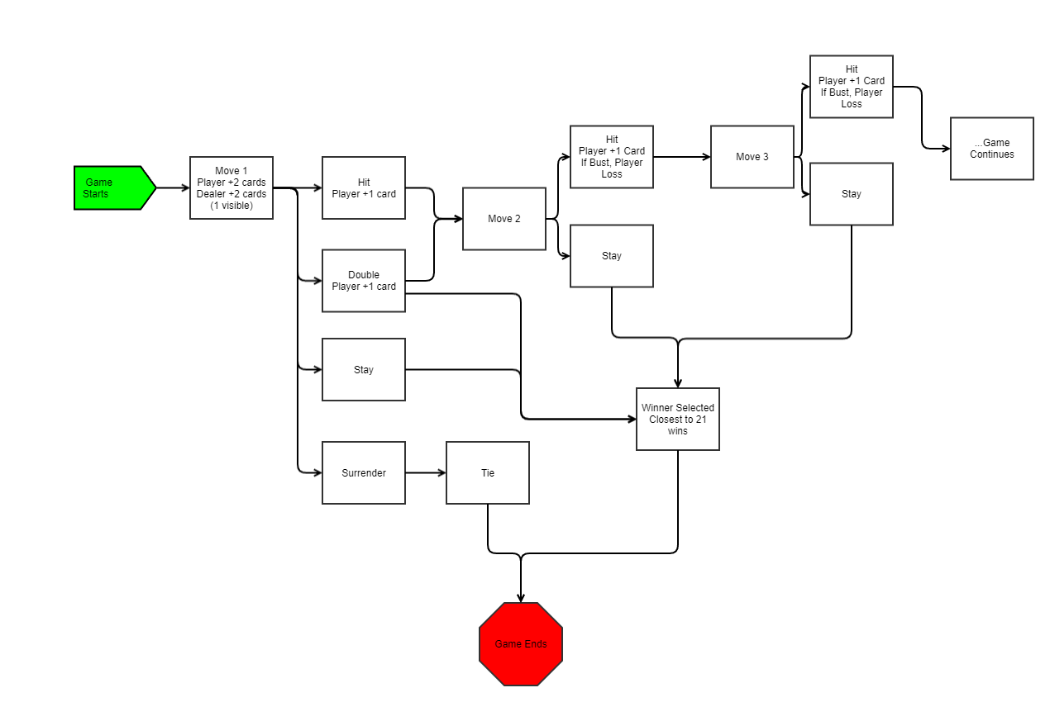


Hit (H)
Stay (S)
Double (D)
Split (P)
Surrender (R )
Insurance (I)
No Insurance (N)

Slide 5


Double down allowed on any first 2 cards
Double down after split allowed
Split any same first 2 cards up to 4 hands
Re-splitting Aces is not allowed
Splitting Aces receives 1 extra card only, no Blackjack
Late surrender Not allowed
No surrender after split
Dealer hits soft 17

Slide 6
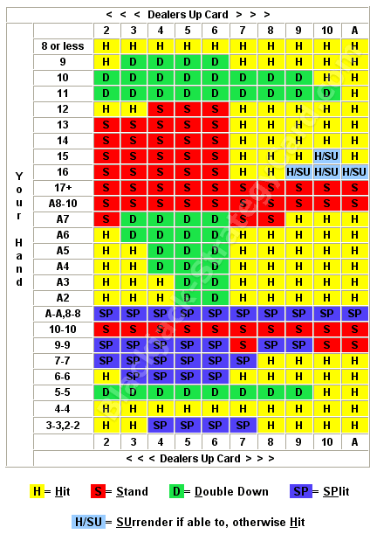

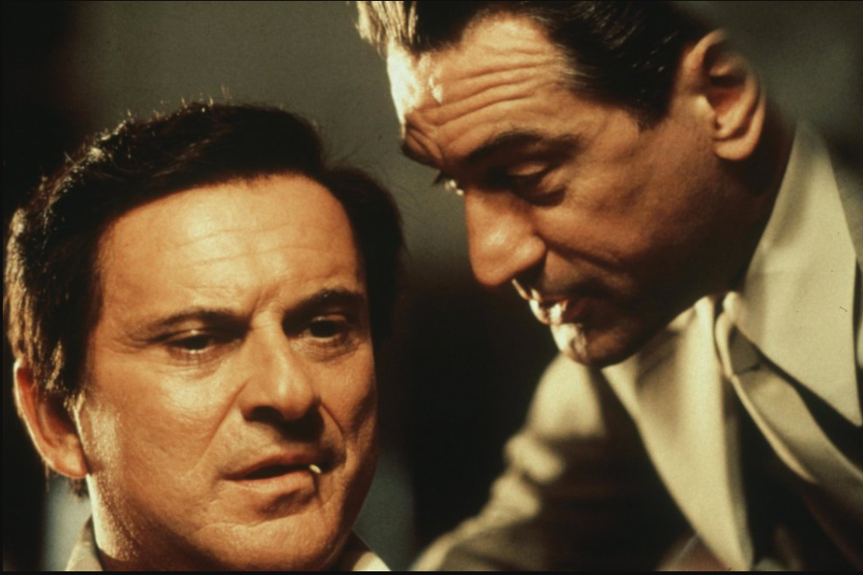

Slide 7

Our Dataset
Cleaning in Power Query
Additional Cleaning in Python

Slide 8

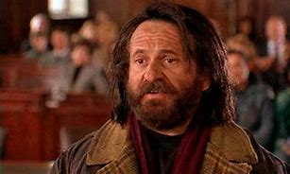

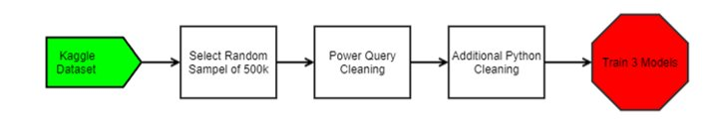
50 Million Blackjack Hands (kaggle.com)

Slide 9



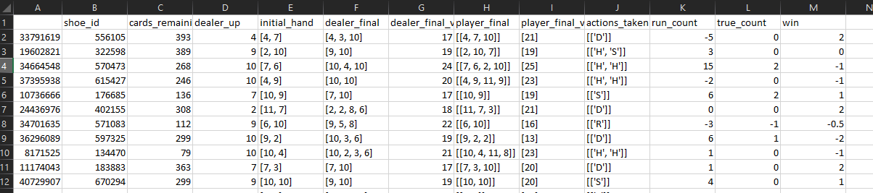

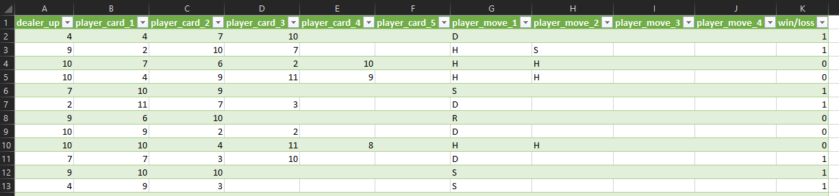

Slide 10

Random Forest Model
Hyperparameter Tuning
Model Accuracy

Slide 11

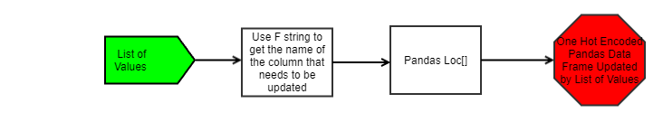

Slide 12

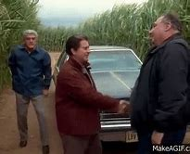


Slide 13

N_estimators: specify the number of decision trees created in the random forest
Criterion 'entropy': determines the function used to measure the quality of a split in each decision tree. Entropy is used specifically for information gain.
Max_features: determines the max number of features considered for splitting a node. This influences the diversity between each tree.
Elected to manually tune our model, commenting out previous iterations and changing values within our parameters in an attempt to improve accuracy.

Slide 14

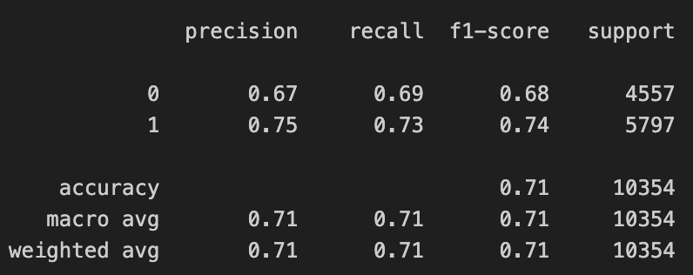
Our Classification Reports indicate:
Consistent Performance across all 3 move predictions
Precision & Recall score balance

Slide 15
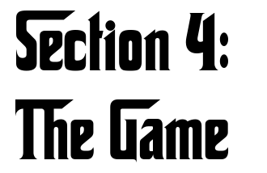
Using AI to assist us in playing Blackjack

Slide 16

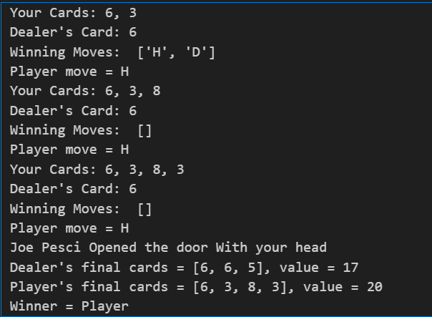
Terminal – Based
Player is prompted to make a move.
Move recommendations are displayed to player.

Slide 17



Get the Data
Clean the Data
Train 3 Random Forest Models
Integrate the models' predictions into a game of Blackjack

Slide 18



Slide 20
1 All introduce
2 Devang
3 Tim
4 Tim
5 Tim
6 Tim
7 Luis
8 Luis
9 Luis
10 Christian
11 Christian
12 Chrisitan
13 Christian
14 Christian
15 Nathaniel
16 Nathaniel
17 Devang
18 All

